Slide 1
Using Lasso Regression to Determine the Mass of the Blackhole
Lara Kamal

Slide 2
Difficulty of Detecting IMBH
Optical:
Dust obscuration
BPT diagnostics not tested in IMBH regime
Broad lines associated with supernova activity
Low Metallicity
Active SF
Radio:
Indistinguishable from compact nuclear starbust
Noise from supernovae remnants, stars, gas/dust emission
Infrared:
Fails in galaxies where stellar luminosity overpowers AGN
Young starbursts can mimic AGN mid-IR colors
X-ray:
Compton thick
Ambiguity of source – XRBs, stellar populations
Notes:
It’s difficult to detect imbh in several wavelengths
For example,
In the radio range, there is noise from the supernovae remnant, stars, gas/dust emission
In the infrared, sometimes stellar luminosity overpowers the AGNs so they are difficult to detect

Slide 3
Accretion Disk
Accretion disk temperature, and peak wavelength emission, depend on black hole mass!
Notes:
From observing the accretion disk of the blackhole and looking at the peak wavelength emission, we can determine the mass of the blackhole

Slide 4
Simulated Spectra
Notes:
As you can see in this graph,

Slide 5
Diagnostic Line Ratios
M_{BH} < 10⁴ M☉
High ratios uniquely identify mid-range BH masses
High ratios uniquely identify low mass BHs
10⁴ M☉ < M_{BH} < 10⁶ M☉
Cann et al. 2018
Notes:
Jenna generated the data

Slide 6
Cloudy Model
Cloudy c17 (Ferland et al. 2017)
Input
Mass: Mass of the blackhole 100 – 10^{8.5} M☉
U: Ionization parameter 10⁻⁴ – 10⁻¹
Hden: Electron density n_{H} Log(n_{H}): 1.5 – 3.5
Output
Al9/Al8(3)
Ca8/Ca5(4)
Mg7(9)/Mg5(13)
Si11/Si9
…..
Fe13/Fe6(1.01)
3
55
Notes:
Jenna generated the data

Slide 7
Dataset
Mass of the BH
Ionization Parameters
n_{H}
Diagnostic Line Ratios

Slide 8
Dataset
Target/Class
Features/Attributes/Elements

Slide 9
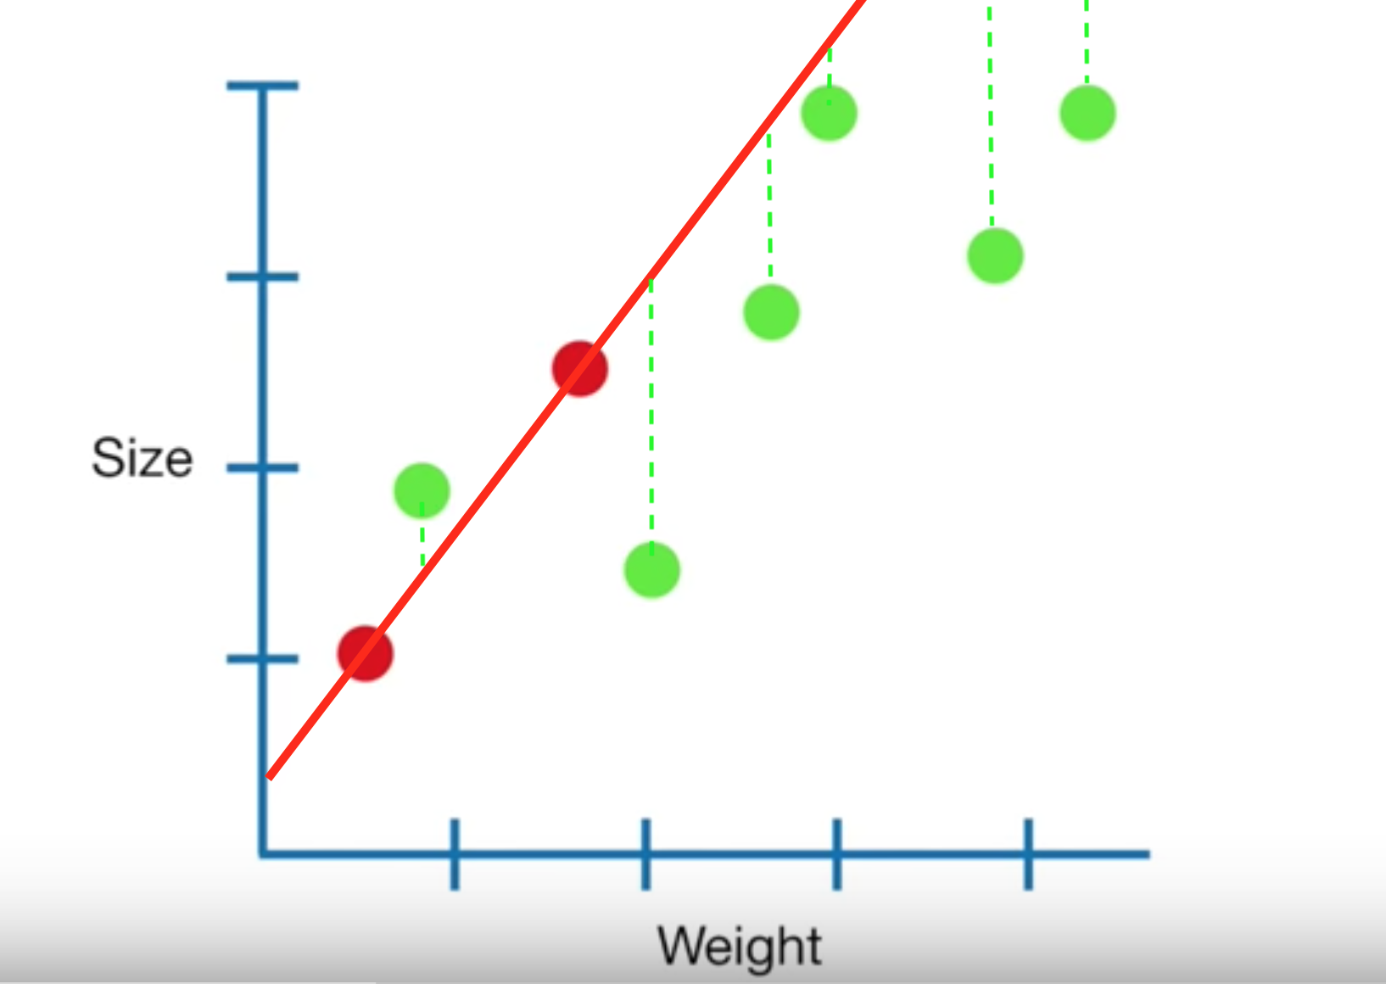
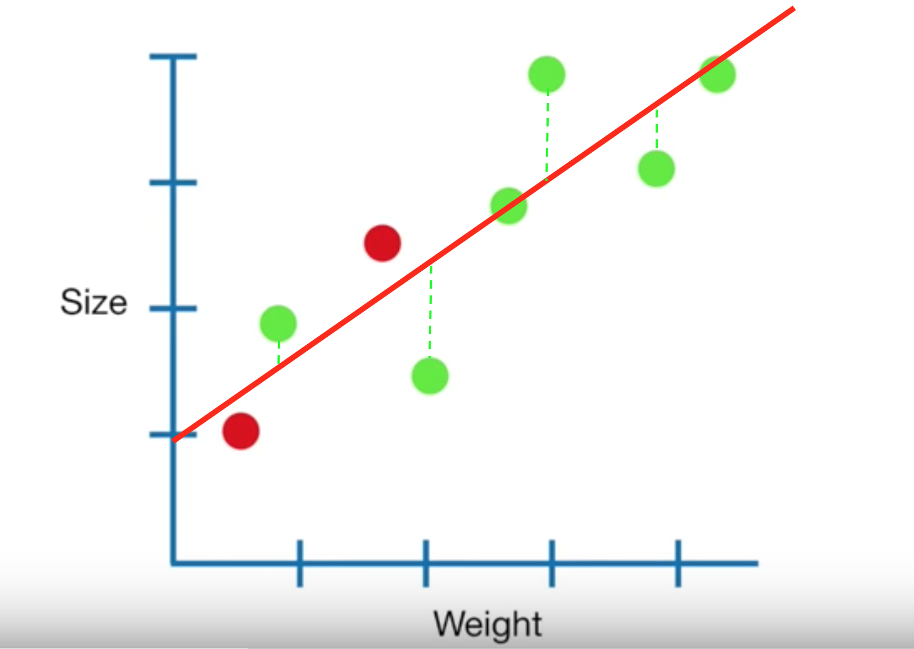
Regression VS. Lasso Regression
Goal: Minimize sum of the squared residuals
Goal: Minimize sum of the squared residuals + ⍺*|slope|, where ⍺ = [0, ∞]
Notes:
Regression: small bias but large variance (overfitting)
Lasso: some bias but small variance
When we increase alpha, the slope = 0

Slide 10
Lasso Regression
The value of ⍺ is determined by cross-validation
n-folds
As we increase ⍺, the weights of some of the features will be 0
Considered as a feature selection method
Notes:
The more we increase ⍺, the more features will equal to zero

Slide 11
Preprocessing
Data cleaning
Missing data = 0
Normalization: z-score
Between: 0 to 1
Box cox Transformation
To normal distribution

Slide 12
Predicting The Mass of the Blackhole
Hyperparameter:
⍺ = 0.0008
max_iter =46000
Number of features = 16!

Slide 13
Performance
Training MSE =﻿ 0.707
Validation MSE = ﻿﻿0.903

Slide 14
Models for Different Ionization Parameters
Use the model to predict the ionization parameter
Different models for:
-1 >= U > -2
-2 >= U > -3
-3 >= U > -4

Slide 15
Predicting Ionization Parameter
Hyperparameter:
⍺ = 0.004
max_iter =46000
Formula:
U = 3.165 * Mg7(5)/Mg5(3) + 1.048 * Na6(14)/Na4(6) + 0.9 * Na7/Na4(6) - 3.1

Slide 16
Performance
Training MSE =﻿ 0.105
Validation MSE = ﻿﻿0.112

Slide 17
Predicting the Mass of the Blackhole
Ionization Parameter -1 >= U > -2
Hyperparameter:
⍺ = 0.002
max_iter =46000
Formula:
M = -1.77 * Mg7(9)/Mg4 -3.88 * Si11/Si6 - 8.01 * Na7/Na4(6) -10.28 * Fe13/Fe6(1.01) -26.19 * Mg5(3)/Mg4 + 0.49

Slide 18
Performance
Training MSE =﻿ ﻿0.668
Validation MSE = ﻿0.595

Slide 19
Predicting the Mass of the Blackhole
Ionization Parameter -2 >= U > -3
Hyperparameter:
⍺ = ﻿0.00414
max_iter =46000
Formula:
M = 26.36 * Mg7(9)/Mg4 + 2.09 * Na6(8)/Na3 + 0.06 * Fe13/Fe6(1.01) - 18.11 * Na6(14)/Na4(6) -28.15 * Na6(14)/Na4(9) + 9.95

Slide 20
Performance
Training MSE =﻿ ﻿ ﻿0.908
Validation MSE = ﻿ ﻿0.953

Slide 21
Predicting the Mass of the Blackhole
Ionization Parameter -3 >= U > -4
Hyperparameter:
⍺ = ﻿0.003
max_iter =46000
Formula:
M = 28.45 * Ne6/Ne5(24) + 3.25 * Si7(2)/Si6 -1.83 * Al9/Al8(3)
-5.07 * Na6(14)/Na4(9) -13.95 * Al8(5)/Al6(9) -34.90 * Na7/Na4(9) + 0.03

Slide 22
Performance
Training MSE =﻿ ﻿ ﻿0.936
Validation MSE = ﻿ ﻿0.969

Slide 23
Comparison
Number of features = 16
Method 2
Method 1
-1 >= U > -2 -2 >= U > -3 -3 >= U > -4
mse = 0.707
mse = 0.035 mse = ﻿0.016 mse = ﻿0.343

Slide 24
Comparison
Number of features = 5~6
Method 2
Method 1
-1 >= U > -2 -2 >= U > -3 -3 >= U > -4
mse = ﻿2.61
mse = 0.668 mse = ﻿0.908 mse = ﻿0.936

